Slide 1
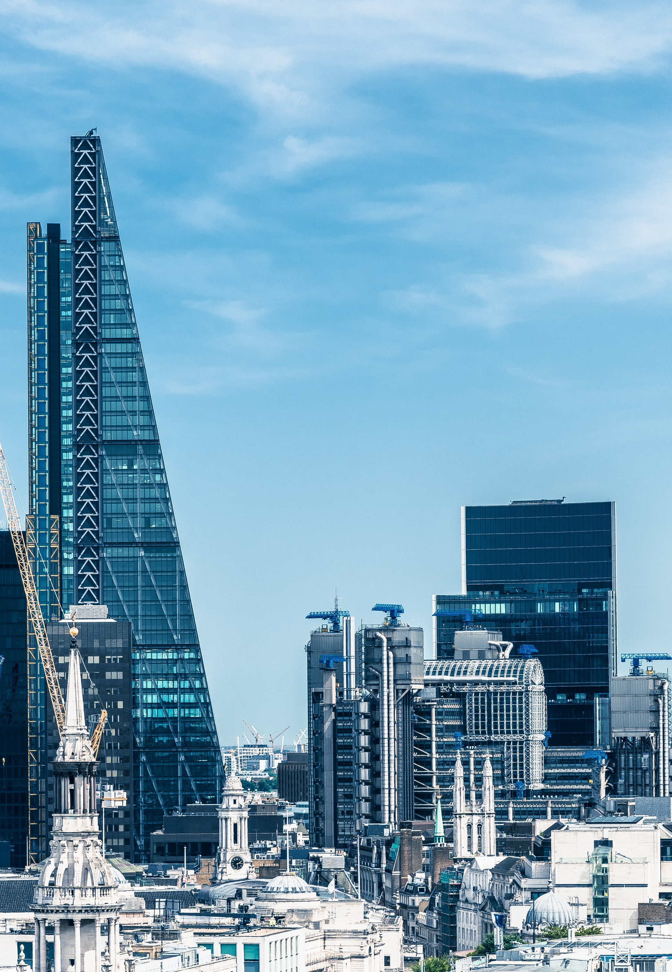
St James Valuation
Proposal for Valuation

Slide 2

Our Services
Steve type bullet points here

Slide 3
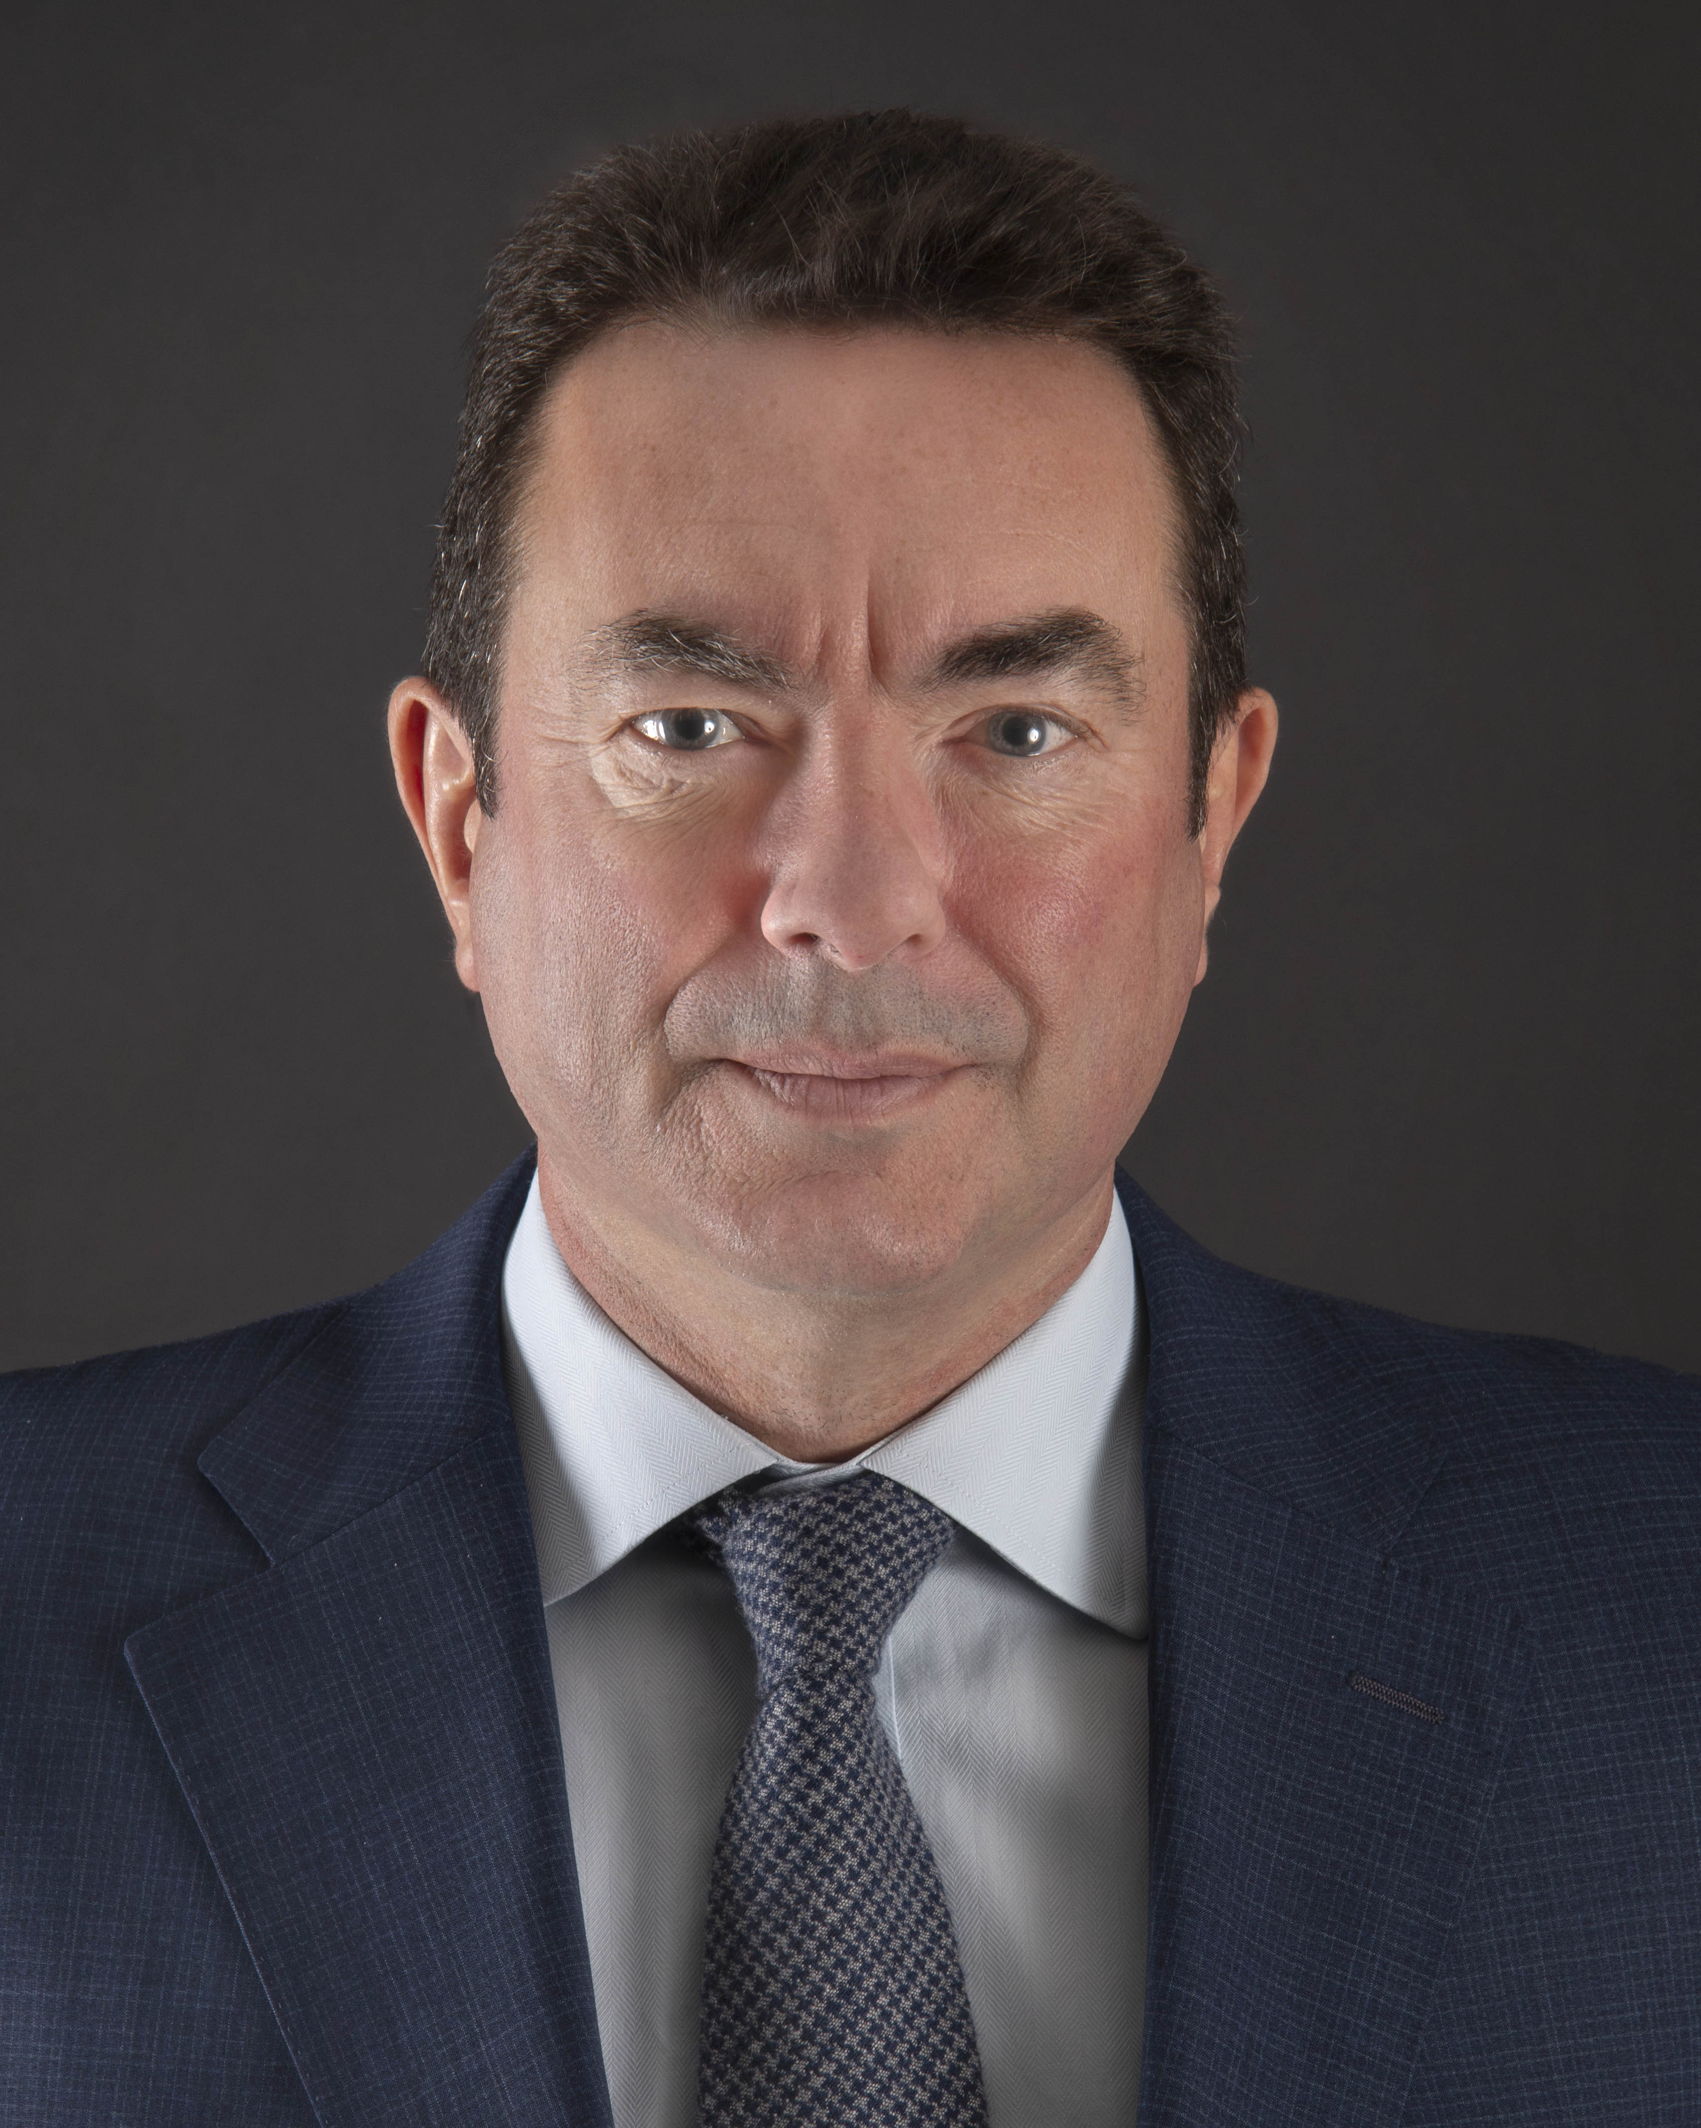
About Us
Lawyers and clients are finding it increasingly difficult to engage valuation experts who are demonstrably independent and genuinely expert in their field. ​ St James Valuation was created to meet this demand, and moreover, to deliver a truly bespoke client centric approach with the partner and senior team actively involved on each and every engagement.
Steve Taylor FCA MEWI
Background
Steve is the founding partner of St James Valuation – a specialist independent valuation boutique focused on family law, commercial, private client and forensic engagements.
Previously he was a senior valuation partner at EY London, where he was the Head of the UK team and the EMEIA region.
Steve has 25 years of valuation experience including two years within the M&A department of Hill Samuel Bank on a broad range of transactions and corporate finance activity.
He has a physics degree from Imperial College, is an FCA, is a Member of the Expert Witness Institute, previously sat on the Special Interests Group for Valuations at the Institute of Chartered Accountants of England and Wales and lectures on valuations at Kings College, London as part of the Business Management Degree.
Steve was made an honouree Member of the Royal Institute of Chartered Surveyors.
+44 (0)779 935 0262
sct@stjamesvaluation.com
Family & court appointments
Acting for the wife of a high profile international executive active in the advertising market;
Acting for the husband in the valuation of a plastics packaging business and presenting springboard arguments;
Acting as SJE on a small media advertising business;
Acting as shadow expert on a set aside motion in an ultra high net worth divorce in a disruptive sports business;
Acted as shadow expert in an ultra high net worth divorce in the London insurance/fintech sector;
Advised one of the UK’s largest data centre operators in quantum following litigation by a customer for breach of contract;
Acted as shadow expert in a multi billion dollar shareholder dispute under Articles of Association between founding shareholder and a global beauty products business;
Acted as SJE on the valuation of a UK specialist distribution business based in Essex;
Acted as SJE on the valuation of a UK manufacturing business based in Sheffield;
Gave evidence in the High Court of Justice on the valuation of a UK technology company as shadow expert for the purposes of divorce and ‘hot tubbed’;

